Slide 1

Indoor Proximity Based Advertising
Using Bluetooth Beacons by Finn Zhan Chen

Slide 2
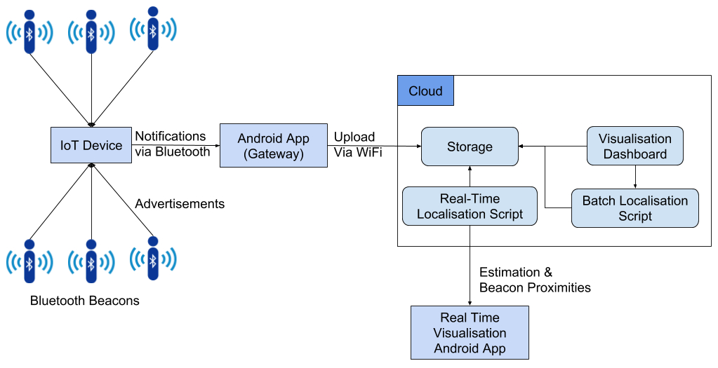
System Structure Overview

Slide 3
Data Collection
And Cloud Storage

Slide 4
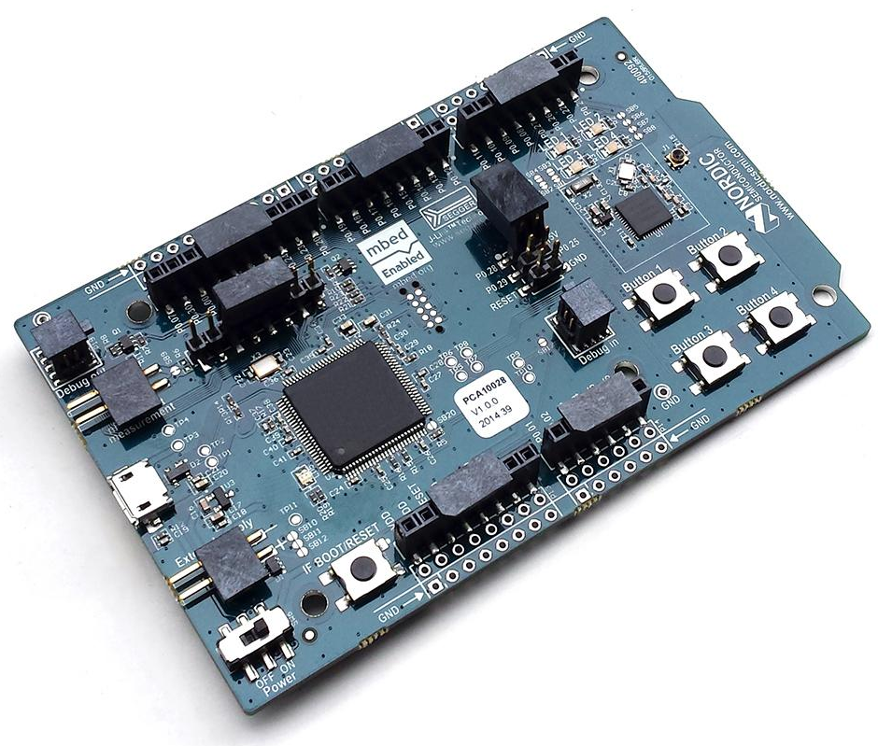
IoT Device Firmware
Scan for advertisements
Filter advertisements
Combine MAC and RSSI
Update custom characteristic
Notifies the subscribed device
nRF51-DK

Slide 5
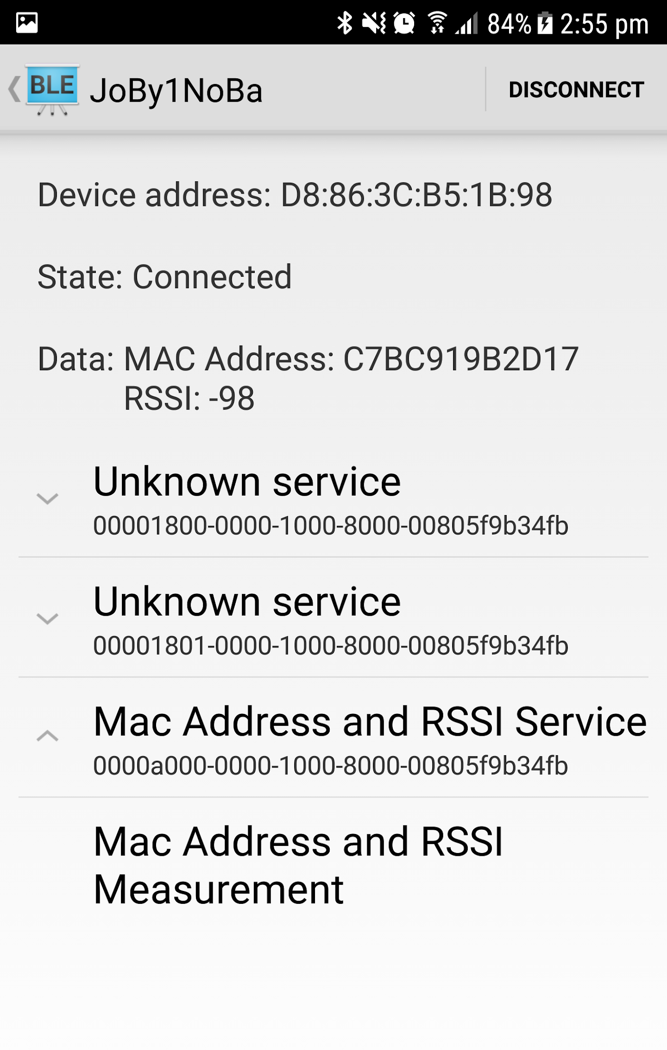
Gateway Android App
Subscribe to IoT device via Bluetooth
Receives notifications
Decodes data
Post data to Cloud via WiFi

Slide 6
The Localisation Algorithm

Slide 7
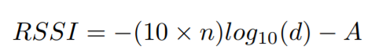
Beacon’s proximity to the IoT device
RSSI is the radio signal strength indicator in dBm
n is the signal propagation constant (n=2 in free space)
d is the proximity to beacon
A is a reference RSSI in dBm (RSSI at 1 metre from beacon)

Slide 8
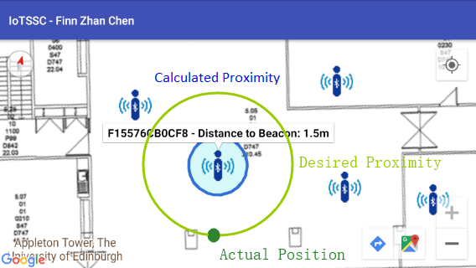
Getting the Reference RSSI (Calibration)
50 RSSIs collected at roughly 1 metres from each beacon.
The noises filtered by removing the outliers.
Averaged to get the reference RSSI.

Slide 9
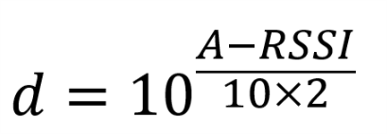
Calculating Proximity Using RSSI
At the time of localisation, the RSSI collected in the past t seconds will be used (t is the data time window).
Noises are filtered by removing outliers.
The mean of the RSSIs is used in the equation.

Slide 10
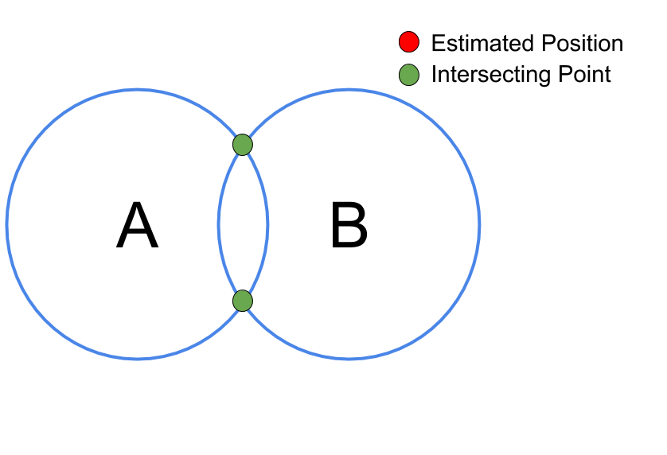
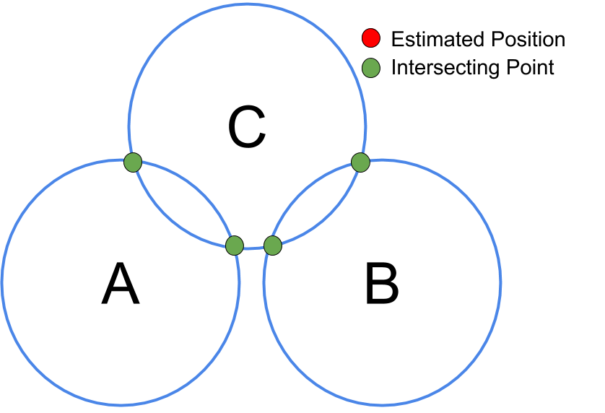
3D Trilateration
Existing Python package for trilateration.
Uses geographic coordinate system (lat and lng)
Weakness:
requires exactly 3 beacons.
must have mutual intersecting points.

Slide 11
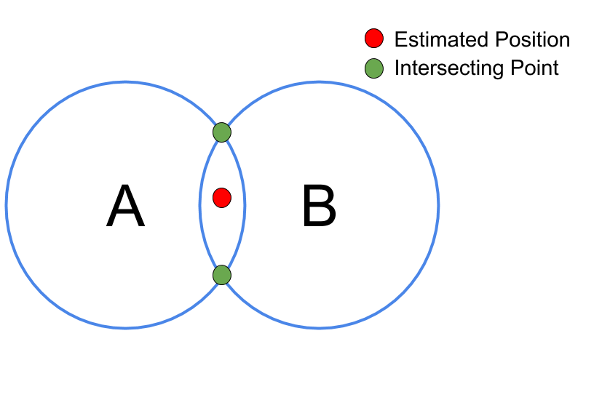
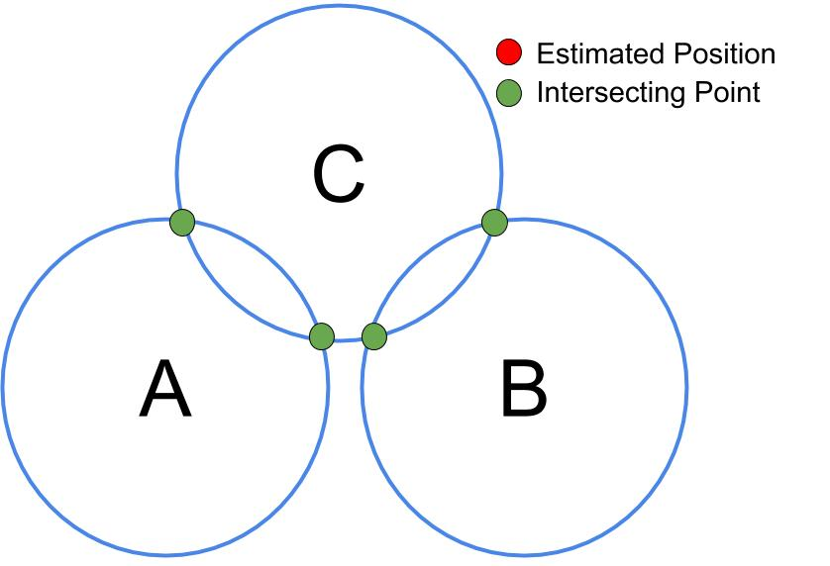
2D Trilateration
Uses cartesian coordinate system(x and y)
Universal Transverse Mercator (UTM) coordinates
Strength:
works with 2 or more beacons
Weakness:
must have mutual intersecting points.

Slide 12
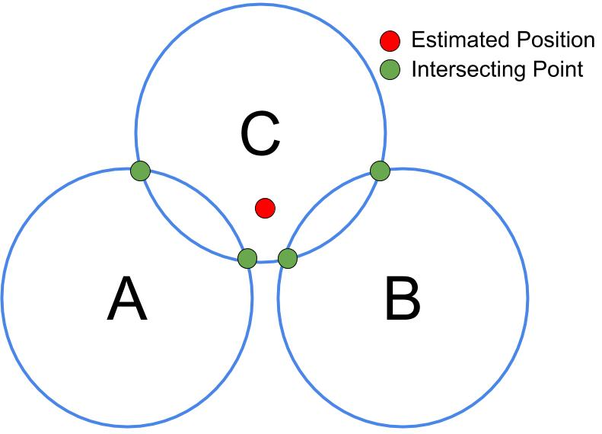
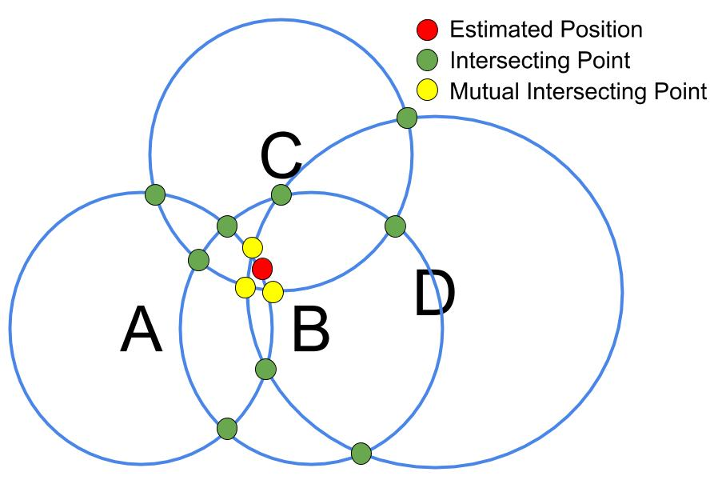
Generalised 2D Lateration
Code modified
Get centre of all intersecting points
Weight based approach
Normal intersecting points weigh 1x
Mutual intersecting points weigh 2x

Slide 13
Generalised 2D Lateration:
Additional Features
Filter discovered beacons >10 metres
Last estimated location as a beacon (If within the past 5s and radius increases 0.5m/s assuming the user moves 0.5m/s)
Estimated location optimisation (Finding X that minimises mean squared error)

Slide 14
Visualisation

Slide 15
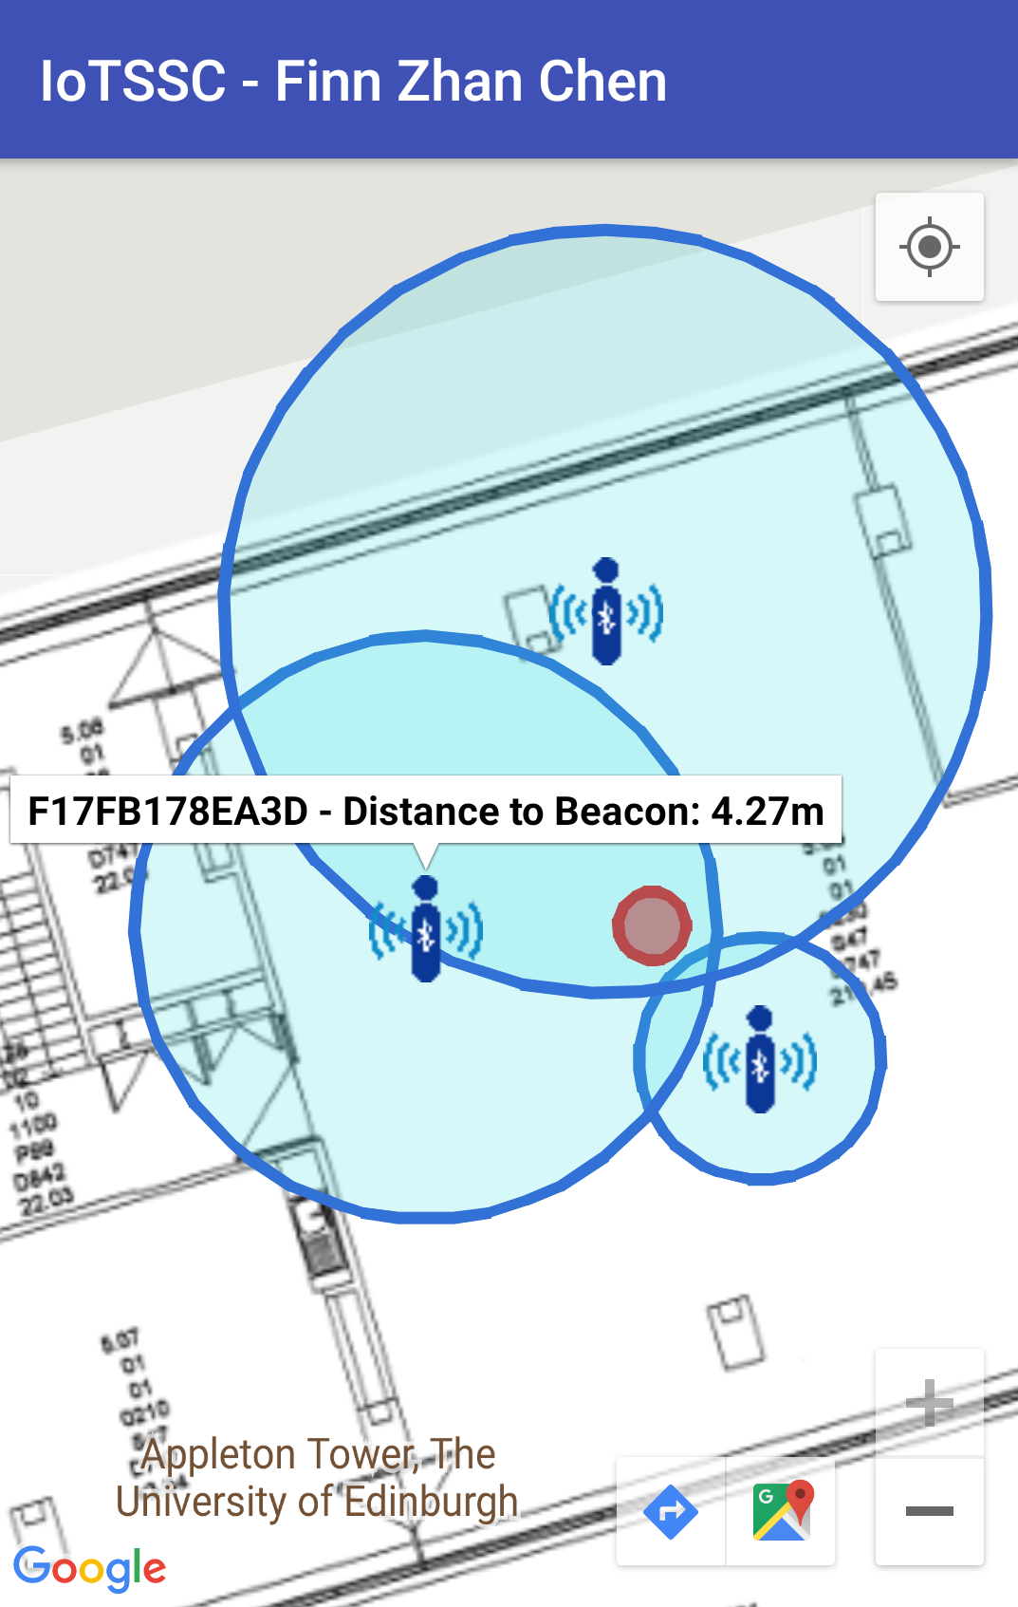
Android App Visualisation

Slide 16
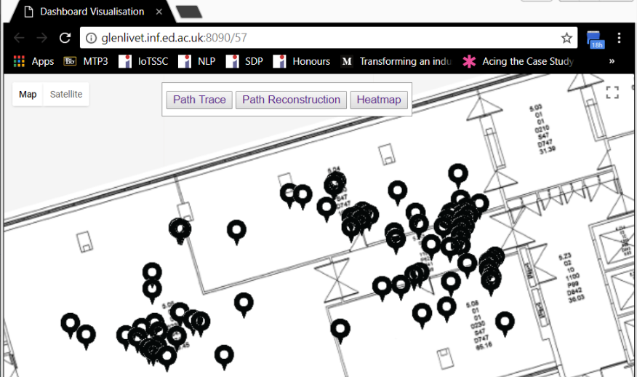
Cloud Dashboard: Homepage

Slide 17
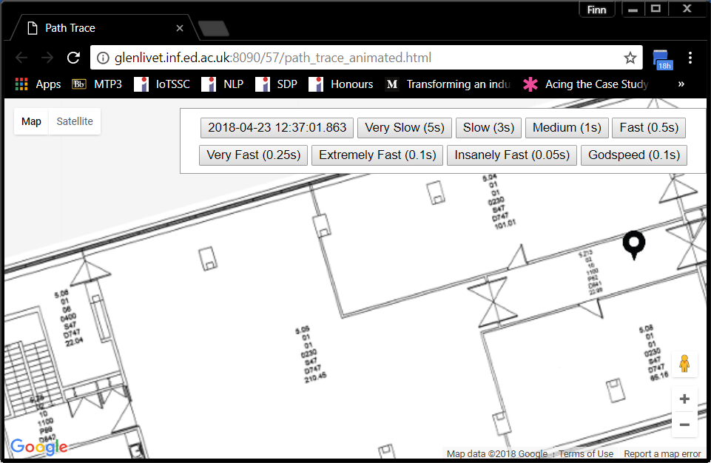
Cloud Dashboard: Path Trace

Slide 18
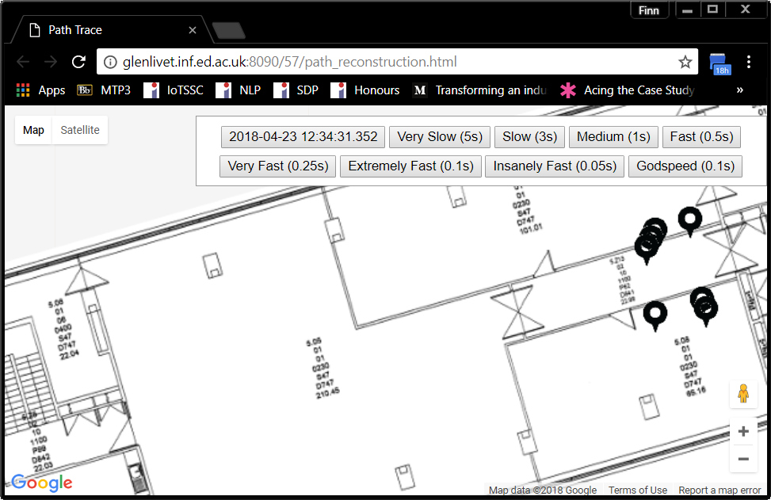
Cloud Dashboard: Path Reconstruction

Slide 19
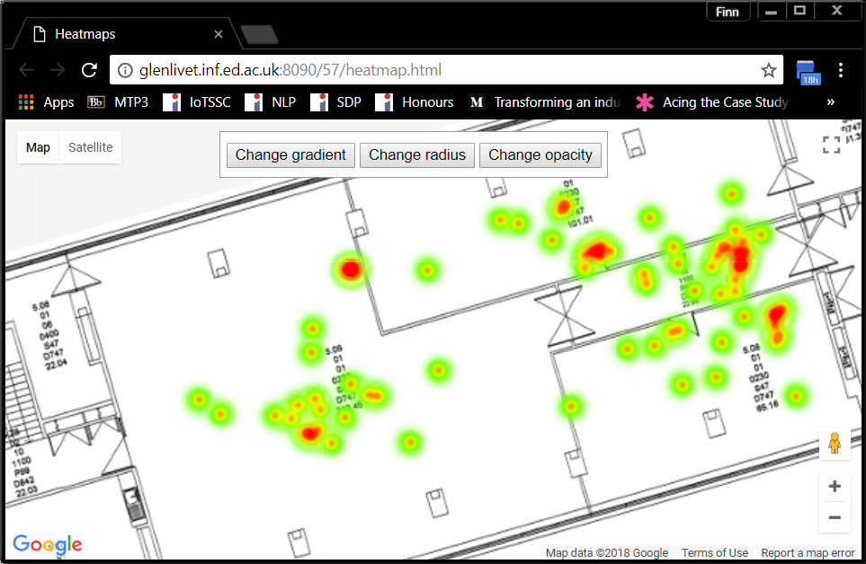
Cloud Dashboard: Heatmap

Slide 20
Performance Evaluation

Slide 21
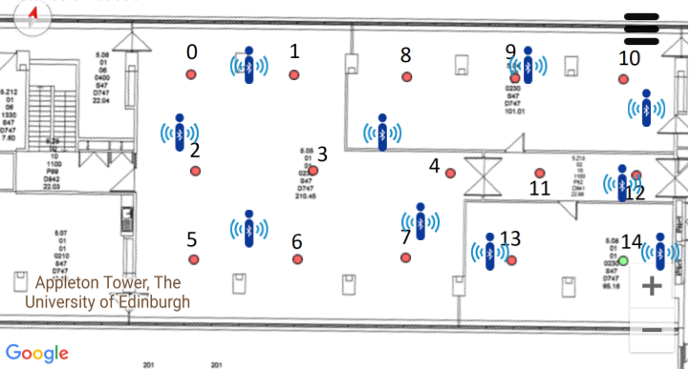
Test Setup

Slide 22
Result
Time at each Test Point: 30s
Time Window for Data: 4.5s
Time Window for Algorithm: 3s
Number of estimated location: 112
Test Point: 0 Number of Estimated Locations: 8 Mean Distance Error: 3.1570353838851464
Test Point: 1 Number of Estimated Locations: 5 Mean Distance Error: 1.0454290095323688
Test Point: 2 Number of Estimated Locations: 6 Mean Distance Error: 3.867109226134572
Test Point: 3 Number of Estimated Locations: 3 Mean Distance Error: 4.209911370221693
Test Point: 4 Number of Estimated Locations: 6 Mean Distance Error: 2.550590978083412
Test Point: 5 Number of Estimated Locations: 6 Mean Distance Error: 4.659396844781046
Test Point: 6 Number of Estimated Locations: 3 Mean Distance Error: 2.641241776631099
Test Point: 7 Number of Estimated Locations: 10 Mean Distance Error: 5.735763376893904
Test Point: 8 Number of Estimated Locations: 6 Mean Distance Error: 3.553800402363198
Test Point: 9 Number of Estimated Locations: 7 Mean Distance Error: 5.096912579179528
Test Point: 10 Number of Estimated Locations: 11 Mean Distance Error: 3.244255123105696
Test Point: 11 Number of Estimated Locations: 9 Mean Distance Error: 2.6440261327014656
Test Point: 12 Number of Estimated Locations: 8 Mean Distance Error: 1.3556790824841536
Test Point: 13 Number of Estimated Locations: 4 Mean Distance Error: 2.233608023472335
Test Point: 14 Number of Estimated Locations: 6 Mean Distance Error: 4.753636728148626
Overall Mean Distance Error: 3.3832264025078826 metres
Notes:
The localisation algorithm on average provides an accuracy of 3.38 metres. The results for the test points provides 1 to 6 metres accuracy depending on environment factors such as wall, furniture, and distribution of the Bluetooth beacons.

Slide 23
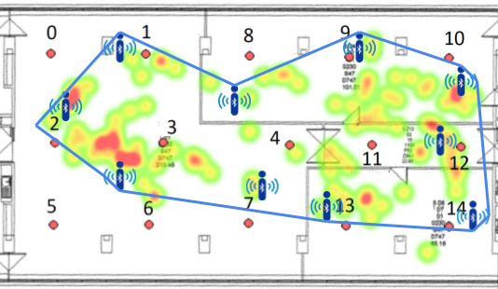
Result Visualised
Notes:
As clearly shown in blue line in Fig, the localisation algorithm is heavily dependent on the Bluetooth beacons and is limited within the blue lines. Limitations: heavility reliant on RSSI, not additional sensors

Slide 24
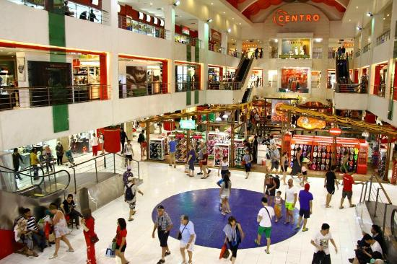

Conclusion & Use Cases

Slide 25
Thanks for Listening

